Slide 1

Risk of Counterfeiting & Gray Market Selling
Presented by: Nishita Lamba

Slide 2
Agenda
01
02
03
04
05
06
Project Objective
Project Background
Data Description
Data Manipulation
Analysis & Insights
Future Scope

Slide 3
PROJECT OBJECTIVE
Identifying brands susceptible to the risk of counterfeiting & gray market selling

Slide 4
02
PROJECT BACKGROUND

Slide 5
Third Party Selling
A third party seller (3P) uses Amazon as a marketplace to sell directly to consumers. These items appear with the labels "Fulfilled by Amazon" or "Ships from and sold by (retailer)". Third parties acquire their inventory by purchasing it directly from the manufacturer, buying it from other retailers, or may be selling goods that are stolen or counterfeit.
According to PlanetRetail RNG, the 3P market is forecast to "account for 64% of global ecommerce sales added through 2022"

Slide 6
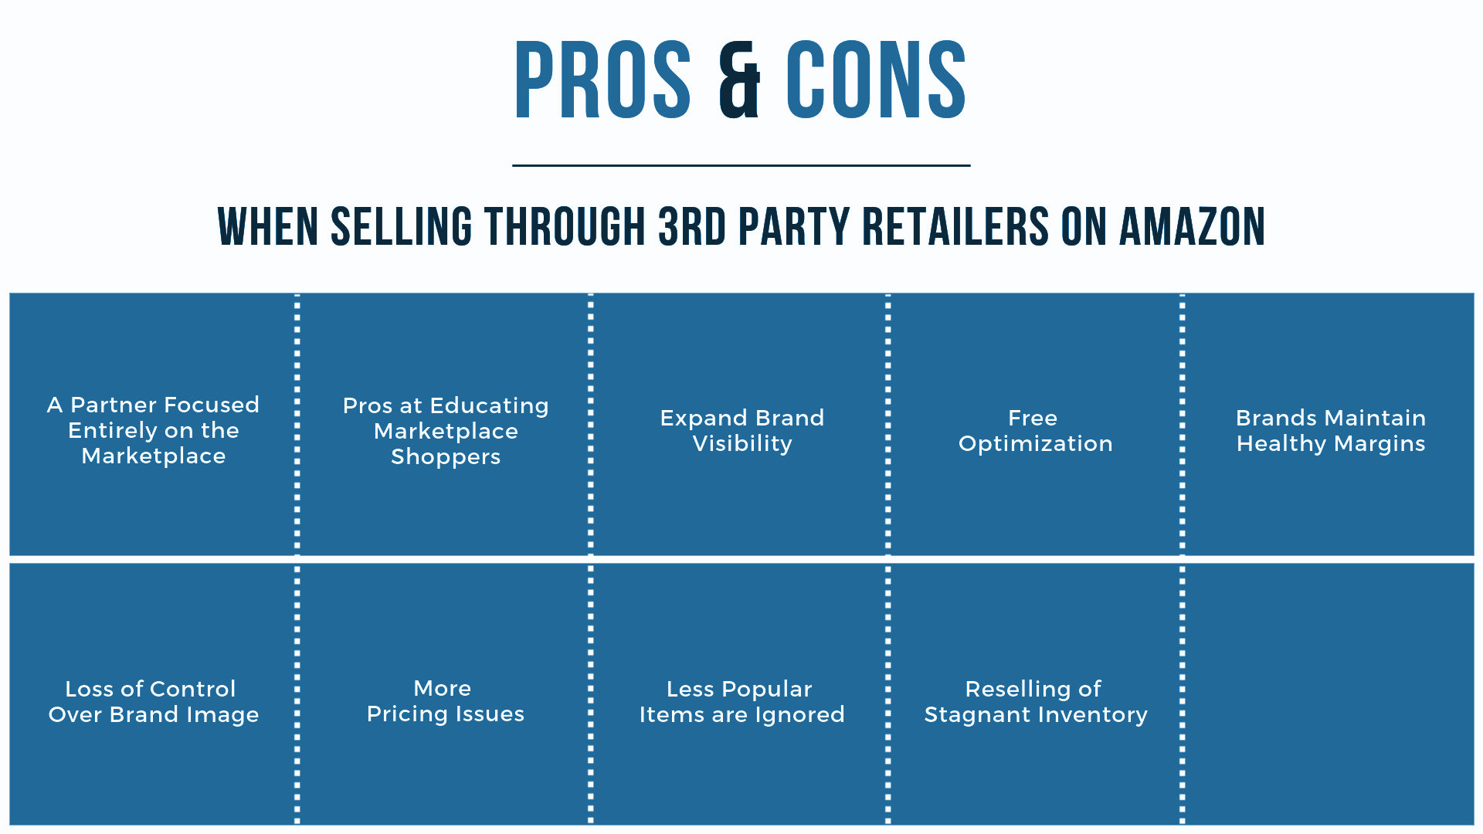
A third party seller (3P) uses Amazon as a marketplace to sell directly to consumers; the 3P is the MOR. These items appear with the labels "Fulfilled by Amazon" or "Ships from and sold by (retailer)". Third parties acquire their inventory by purchasing it directly from the manufacturer, buying it from other retailers, or may be selling goods that are stolen or counterfeit.
According to PlanetRetail RNG, the 3P market is forecast to "account for 64% of global ecommerce sales added through 2022"
Source: https://intheamazon.com/2019/02/21/the-pros-and-cons-of-selling-through-3rd-party-retailers/

Slide 7
Step 1
Step 2
Project Approach
Tools Used:
Python
Pandas
scikit-learn
Jupyter Notebook as an IDE
Numpy
Nltk library
Vader sentiment
Seaborn
Natural Language processing
Secondary Research
Primary Research (Quantitative)

Slide 8
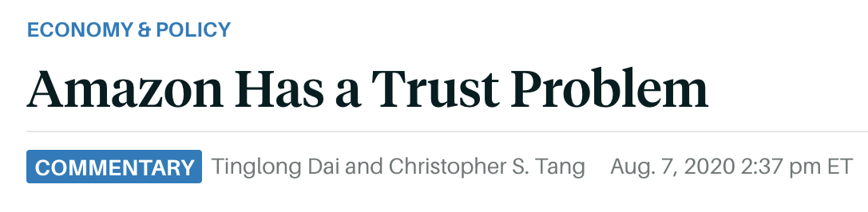
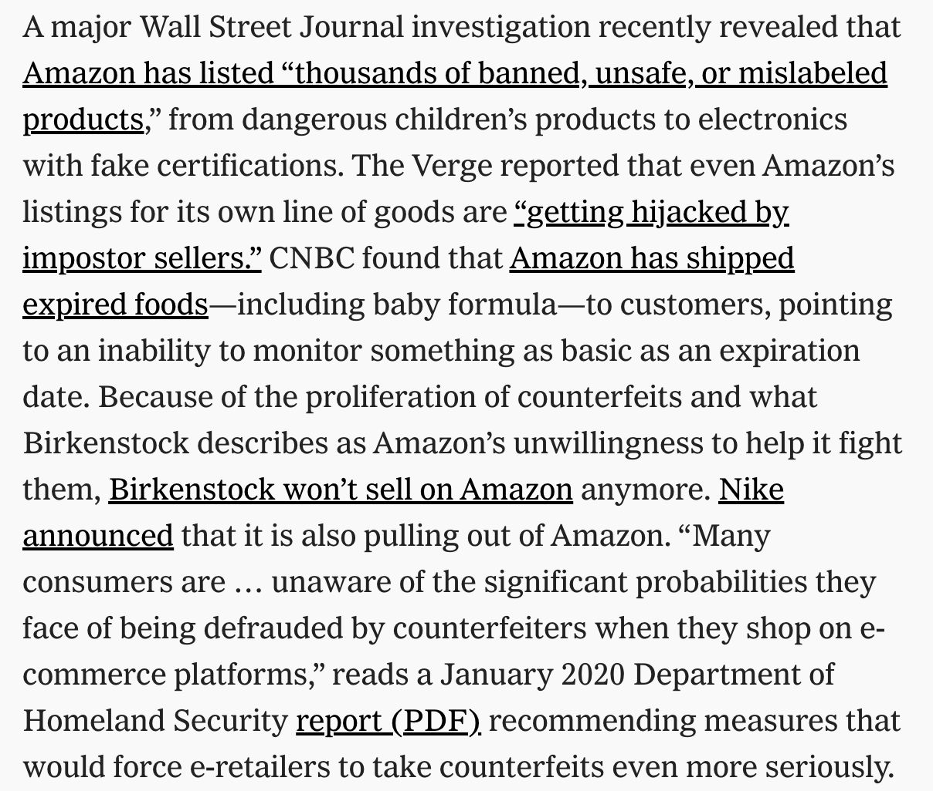
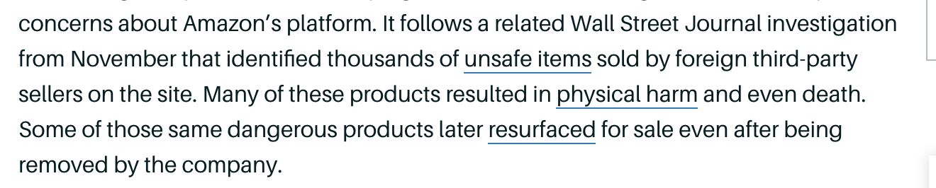
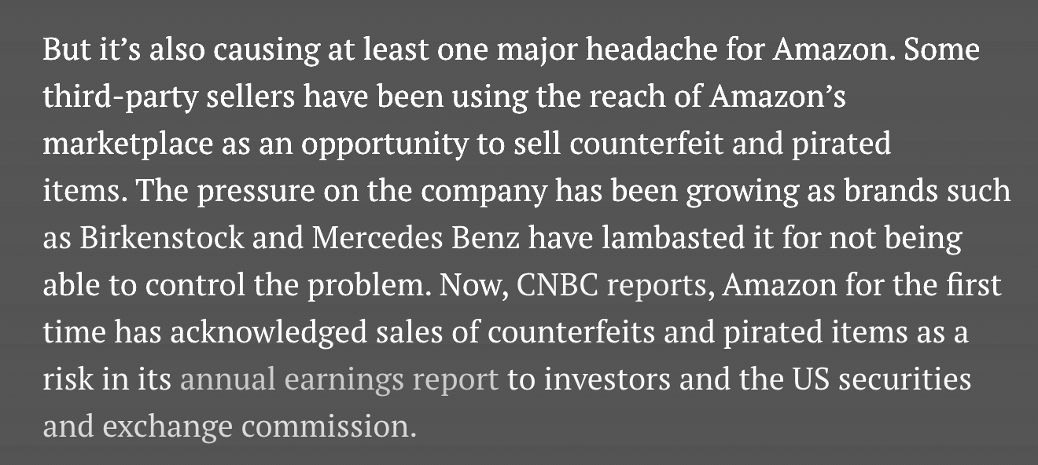
Secondary Research

Slide 9
Amazon counter dataset
Product review dataset
Number of Observations: 359069
Number of features: 28
Product ids are not unique: multiple reviews and ratings for each product
Lot of missing data
Date range: 2000-01-27 to 2018-06-29
Data for 18+ years
DATA DESCRIPTION

Slide 10
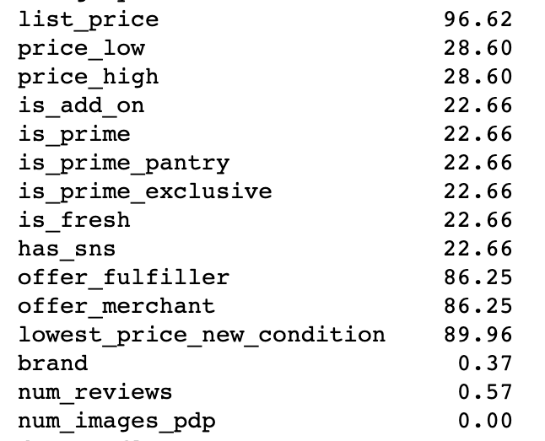
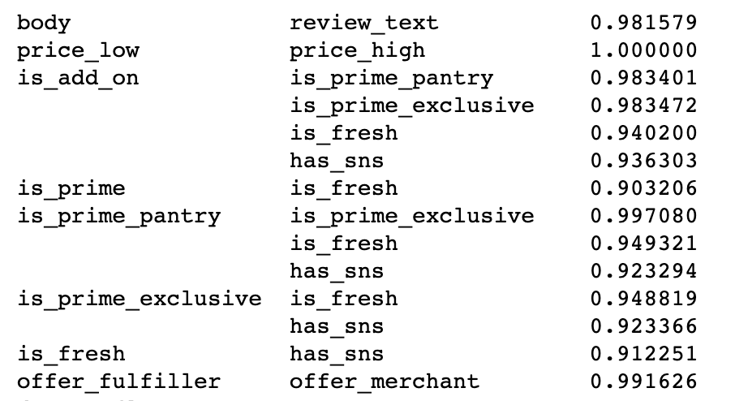
Amazon counter dataset
Correlation:
highly correlated columns
Negative values: None
Missing values:
DATA PREPROCESSING
Dropped columns where null values are more than 80 %

Slide 11
Dataset
DATA MANIPULATION
Numerical columns
Categorical columns
Product Review column
Impute with mean/max occurring value for each product id.
For price, fill NA with 0 and create binary column to indicate missing rows.
Impute with max occurring value for each product id.
missing brands - fill NA with ‘Unknown’.
Used label encoder to encode categorical data .
Dropped rows with missing reviews.

Slide 12
Step 1
Step 2
Step 3
Step 4
Project Approach with Text Data
Data Cleaning & Preprocessing
Develop sentiment classifier
Compile reviews for each product id
Pick products which have the word fake/duplicate in reviews

Slide 13
Data Cleaning & Preprocessing
Product reviews using an automated system can save a lot of time and money. At the same time, the probability of error is lower.
2 columns: body and review text
Body is the full review whereas review text gives only the relevant text; removing stopwords. The text in this column is ready for analysis.
So my further analysis focuses only on review text.

Slide 14
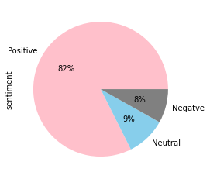
Sentiment Analysis
To classify the reviews as positive and negative reviews
Mean rating for each sentiment
Negative 2.4
Neutral 3.6
Positive 4.4
Built a sentiment classifier for review_text column using Logistic regression and count vectorizer.
Accuracy achieved: 95%
Positive
Negative
Neutral

Slide 15
Sentiment Analysis
Compiled reviews for each product and filtered for words ‘fake’ & ‘duplicate’
Total - 2201 words
Eg: “this bag fake. i paid full price imitation bag”
Calculated the total occurance of those words in the compiled review for each product
Calculated rate of occurrence : dividing total occurance by the total number of reviews with the words.
Total reviews with positive rate of occurrence : 651

Slide 16

INSIGHTS

Slide 17
116
4280
675
Key Numbers
Brands susceptible to counterfeiting
Reviews containing the word ‘fake’
Fake products

Slide 18

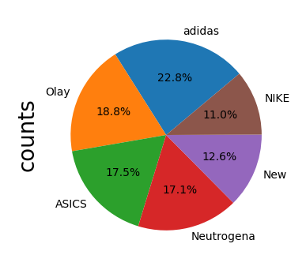





Brands Susceptible to Counterfeiting
116 brands out of the total 237 brands in dataset
Top 6 brands

Slide 19
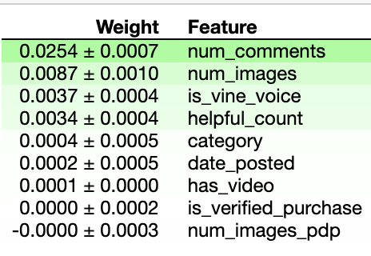
Factors affecting ratings of products
For the fake product dataset
Given that the products in the data are classified as fake, the ratings of those products are directly affected by the number of comments and images on the review, helpful count and also if the reviewer is a vine reviewer hired by Amazon

Slide 20
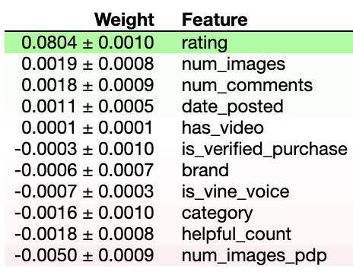
Factors affecting sentiment score of reviews
For original dataset
Duplicate/Near Duplicate Reviews (DUP): Identical or quasi identical reviews may indicate a spamming behavior.
Spammers will try to divert the average sentiment on reviews, by placing theirs. And likewise, they can also influence the ratings/helpful count of the products. So, positive ratings or reviews are not necessarily a good measure of the authenticity of products.
According to analysis, the number of images and comments in review also influences the sentiment score of product reviews.

Slide 21
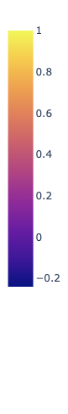
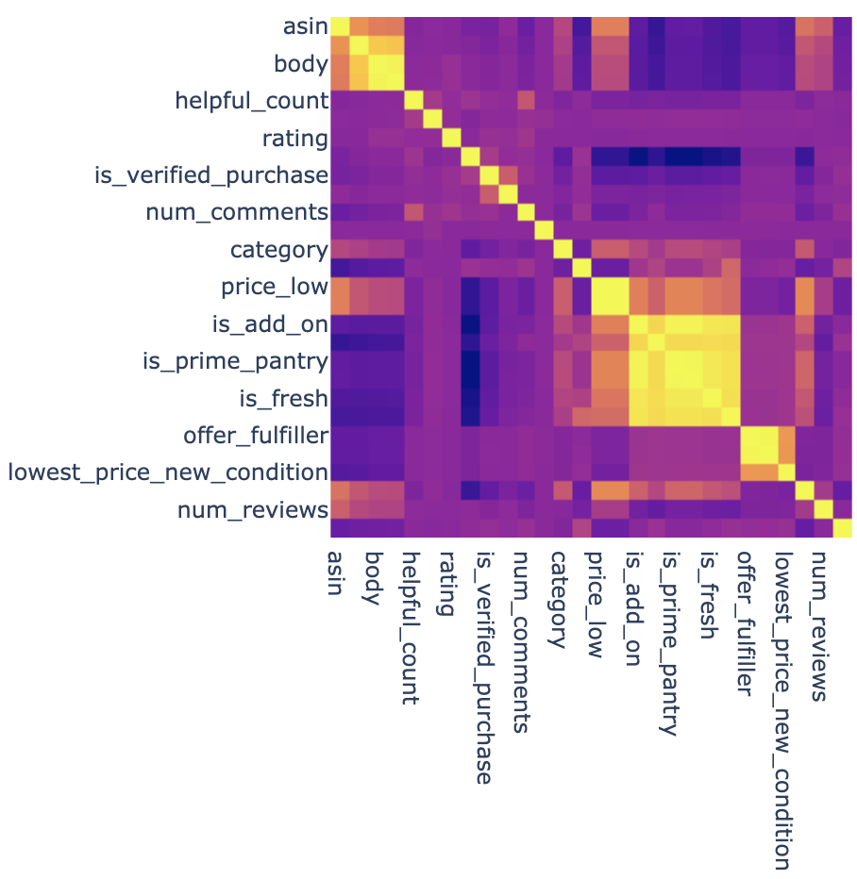
Offer fulfiller & Offer merchant are not same
If offer fulfiller and offer merchant are different then there is a chance of counterfeiting or gray market selling.
43694 reviews where offer fullfiller and offer merchant are same
offer fulfiller and offer merchant are highly correlated
Correlation Plot

Slide 22
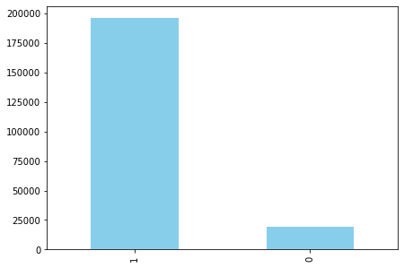
Being verified purchase does not mean authentic
For Fake products dataset identified by NLP
Majority purchases of fake products are verified i.e. validated and trustworthy reviews
Verified
Not Verified

Slide 23
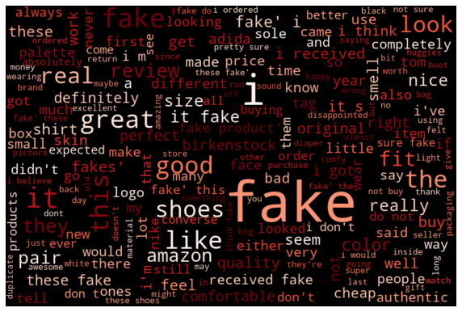
Wordcloud for fake product classifier
It has a lot of negative words but also has positive ones like ‘real’ and ‘great’ which suggests fake reviews.

Slide 24

Future Scope
Gather more info about shipper and seller since this can be the main contributing factor to determine gray market selling.
Use web scraping to collect more data related to the products in order to fill the null values more accurately.
Try to scrape minimum and maximum price at which the product has been sold to determine gray market selling. More the difference between the two, more the probability.

Slide 25
Thank You

